Slide 1


Dissecting Harmful Memes for Semantic Role Labelling
Presented By:
Jim James (CS20MDS14022)
Sayantan Sarkar (CS20MDS14027)
Siddharth Tandon (CS20MDS14021)
Faculty: Maunendra Sir & Srijith Sir
Mentor: Kaushal

Slide 2
Problem Statement
Given a meme and an entity, determine the role of the entity in the meme: hero vs. villain vs. victim vs. other. The meme is to be analysed from the perspective of the author of the meme.
Role labelling for memes: This task emphasizes detecting which entities are glorified, vilified or victimized, within a meme. Assuming the frame of reference as the meme author's perspective, the objective is to classify for a given pair of a meme and an entity, whether the entity is being referenced as Hero vs. Villain vs. Victim vs. Other, within that meme.
Entities:
Hero: The entity is presented in a positive light. Glorified for their actions conveyed via the meme or gathered from background context
Villain: The entity is portrayed negatively, e.g., in an association with adverse traits like wickedness, cruelty, hypocrisy, etc.
Victim: The entity is portrayed as suffering the negative impact of someone else’s actions or conveyed implicitly within the meme.
Other: The entity is not a hero, a villain, or a victim.

Slide 3
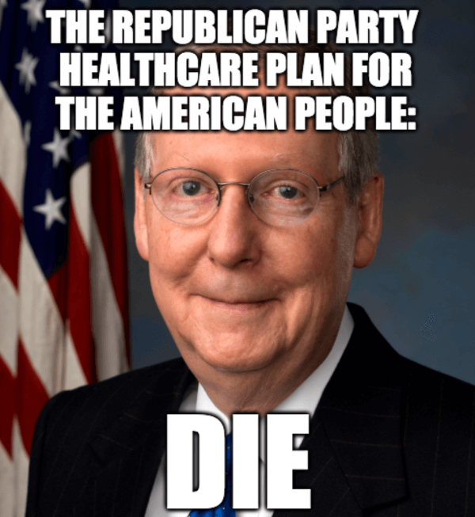
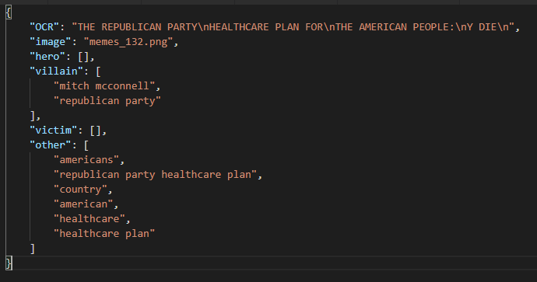
Data Sample
memes_132.png
Meme image
Annotation with Entities categorised into “hero”/”villain”/”victim”/”other”
Entity Count | Text Entities | Image Entities
17514 | 82% | 18%
**similar dataset is present and was used for covid19 memes as well

Slide 4
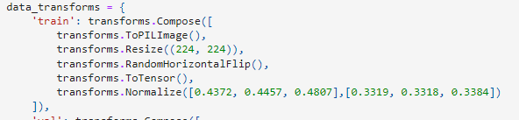
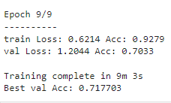
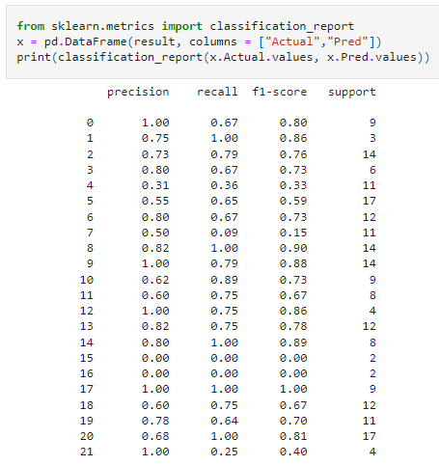
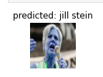
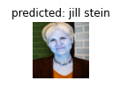

Data Preparation(image modality)
Image standardization
After the image standardization is done, we tuned a pre-trained resnet18 model on a handpicked set of entities, this is to learn the features of the entities from the meme images if they are not present or cannot be extracted from OCR texts
Performance of the resnet18 in classifying the entities from image
Some examples of the resnet18’s prediction on the entities is shown below: For 22 of the majorly occurring entities in the dataset, we improved the model’s performance by training it on an extra set of images for each of these 22 entity from the web.

Slide 5
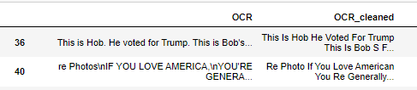
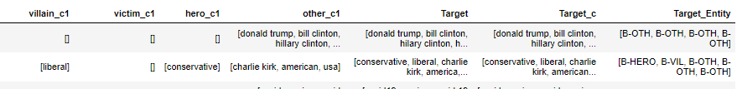
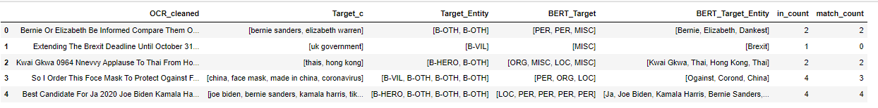
Data Preparation(text modality)
OCR text & entities under all categories
Special char, punctuation etc removal
Entity standardization with fuzzy string matching(Hiliary Clinton->Hillary Clinton)
Lemmatization
Prepare entity tags from input
Target entity tagging:
Other: B-OTH
Hero: B-HERO
Villain: B-VIL
Victim: B-VIC
Bert based entity extraction(pretrained: bert-large-NER)
It can be seen from the above table that, the bert ner model was able to extract the entities very close to what was given in the input dataset. The last two columns represent the number of entities the dataset had and how many matching entities the bert was able to extract. For example: the first meme had bernie sanders & Elizabeth warren in the dataset and the bert was able to extract both of these in its output. **here also we have taken fuzzy matching logic to find the intersection

Slide 6
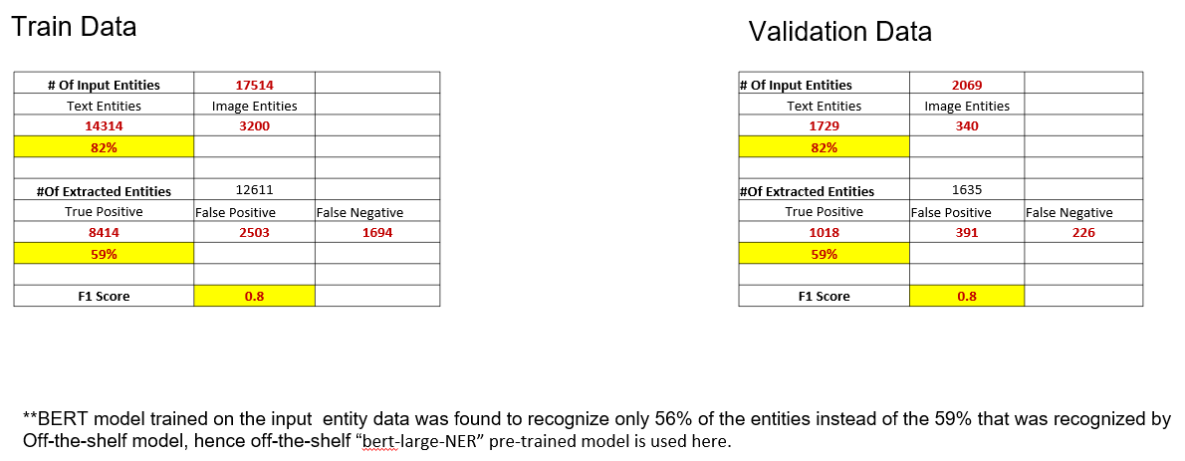
Data Preparation(Metrics)

Slide 7
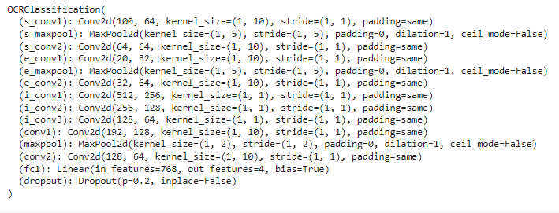

meme annotations
Fusion of both modalities
meme images
Standardize images
pre-process ocr text and entities
retrieve the predicted entities
Push images through pre-trained resnet18
get sentence embedding from pre-trained bert model
get entity embedding from pre-trained bert model
retrieve the layer4 feature map
concatenate all feature vectors from sentence, entity & images
hero
Train with custom classifier class on target class: hero/villain/victim/other
villain
victim
other

Slide 8
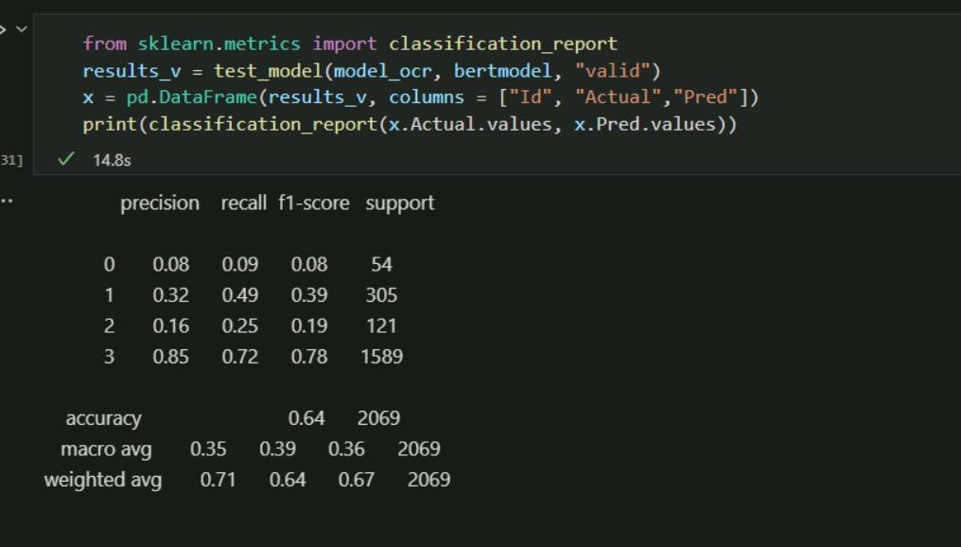
Current performance and improvements
Enhance the image classification model(fine-tuning resnet18) by adding more training samples/ leveraging face identification/ object detection models
Improve NER model by leveraging pre-trained object detection models and fine tuning existing BERT NER model
Try out more advanced architecture with attention mechanism to handle the fusion of image & text features.
0: hero
1: villain
2: victim
3: other

Slide 9
Reference Papers
Detecting Harmful Memes and Their Targets 2110.00413.pdf (arxiv.org)
Can images help recognize entities? A study of the role of images for Multimodal NER 2010.12712.pdf (arxiv.org)
Object-Aware Multimodal Named Entity Recognition in Social Media Posts With Adversarial Learning IEEE Xplore Full-Text PDF:
A MULTIMODAL DEEP LEARNING APPROACH FOR NAMED ENTITY RECOGNITION FROM SOCIAL MEDIA 2001.06888.pdf (arxiv.org)
ConcatBert: Supervised Multimodal Bitransformers for Classifying Images and Text (https://arxiv.org/pdf/1909.02950.pdf )

Slide 10
Thanks

